Slide 1

Introduction to Data & More Compliance Solution & Classification principles

Slide 2
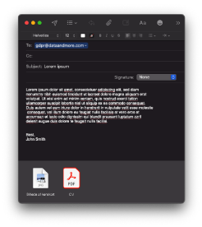





















14.
Data & More’s unique method to delete illegal data
Comprehensive solution with markets best and full pre build classification
1
2
3
4
5
6
7
Solution approved by IT security with access to the
relevant data sources
Automatic identification of personal sensitive data in all connected data sources
Automatic
non-compliant
Document classification
Advanced rules & policy engine to determine what is compliant or not
Compliance insights, risk assessment reporting and analysis
Informing and dialogue with employees about their non-compliant data
Automated clean-up policies
Job application
Analytics
Data subject
Time
Move files
Personal Data
Role
Clean-up mail
Location
Content
DPO
responsible
Delete files
Clean-up report
Picture of driver’s
License & CV
Non-compliant data
Dispensation
Compliant data
Head of
departments

Slide 3
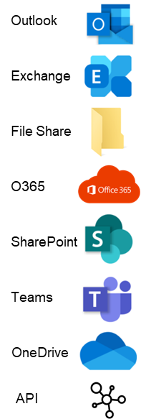



Data & More Compliance Solution– how it works
Repositories:
Data & More Toolebox
Text extraction / OCR
Language detection
Profiling with dictionaries, algorithms and AI person recogniction – AI
Tagging
Document Classification
Policies
The file
Files attributes stored and when it was profiled
Language
Labels
Tags
Document Class
Policy
The full text of the file
All the properties of the file and the language of the text in the file
If there is a match it is identified, and all files are labeled with the name of the dictionary or algorithm
Label=“name of dictionary”, “name of algorithm” or name of AI
Tags are use ad general support tools for document classification and policies. A tag is a rule, and if there is a match on the rule all files are tagged with the name of the tag
Tag=“name of tag”
Will try to classify non-compliant files into different document classes.
Document classes are like tags, a rule. All files matching a document class rule are marked with the name of the document class.
Document Class = “name of document class)
Are used to notify, move and delete non-compliant files. Policies are also rules. All files matching a policy are marked with the name of the policy. Policy = “name of policy)
The file now has additional attributes
Account / Creater
Creation Date
document age
Edited date
File size
Id
Last modifed date
Name
Profiled age
Profiled date
Source
Text value
+
Label
+
Tags
Tag Categories
+
Class
Class Categories
+
Policies

Slide 4
The original file
The Data & More Compliance Server
OCR & AI face recognition & language detection
Dictionaries & Algorithmes & AI
Tagging
Document classes
Policies
Text
Text
Text
Text
Text
Text
Properties
Properties
Properties
Properties
Properties
Properties
OCR +face
OCR +face
OCR +face
OCR +face
OCR +face
Label
Label
Label
Label
Tags
Tags
Tags
Doc Class
Doc Class
policy

Slide 5
Data & More Compliance Solution – Classification principles
Doc Class Categories
A collection of Doc classes
Doc Class
policy
Doc classes constitute of all the relevant tags
Polices use Doc Classes & tags to define a set of files to be notified or clean-up
Tags Categories
A collection of tags
Tags
Subcomponents of a doc classification (could be per language, different versions of a classification etc.
Text
Properties
Label
Face
Body text of a files
All the different properties
Regex & Dictionaries
PII Face: Yes/No
No of faes

Slide 6
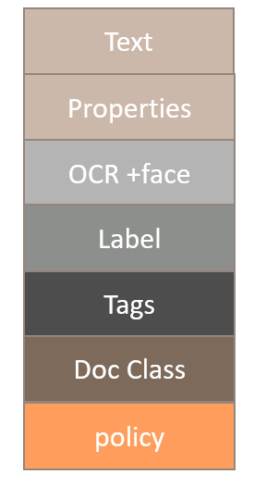
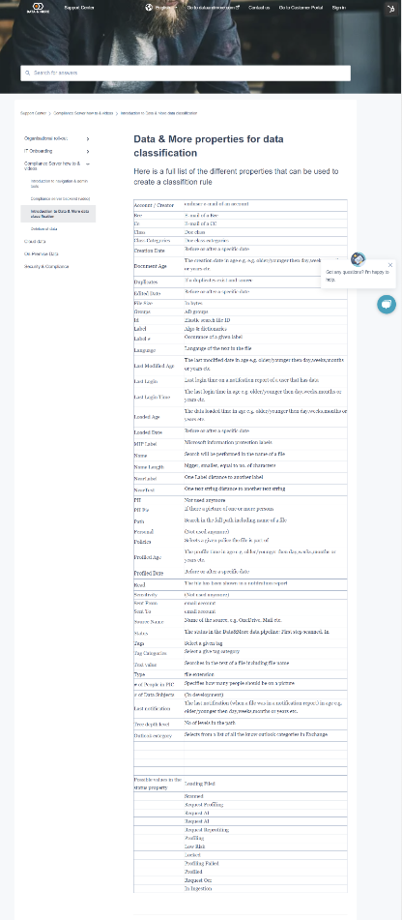
Data & More Compliance Solution– Enhanced file intelligence attributes that can be used to have the best possible classification
Se the full list of all available properties on:
https://support.dataandmore.com/en/knowledge/data-more-properties-for-data-classification
All this information is actionable and usable in the Data & More toolbox, to be used for:
Tagging
Document Classification
Policies

Slide 7
Data & More Compliance Solution – Classification principles
Example for a passport tag:
Tags
=
Text
+
Text
Face
FP Tags
+
-
Tags
=
Label
FP Tags
Text
+
-
Tags
Properties
FP Tags
=
-
=
+
Tags
Label
Text
Properties
-

Slide 8
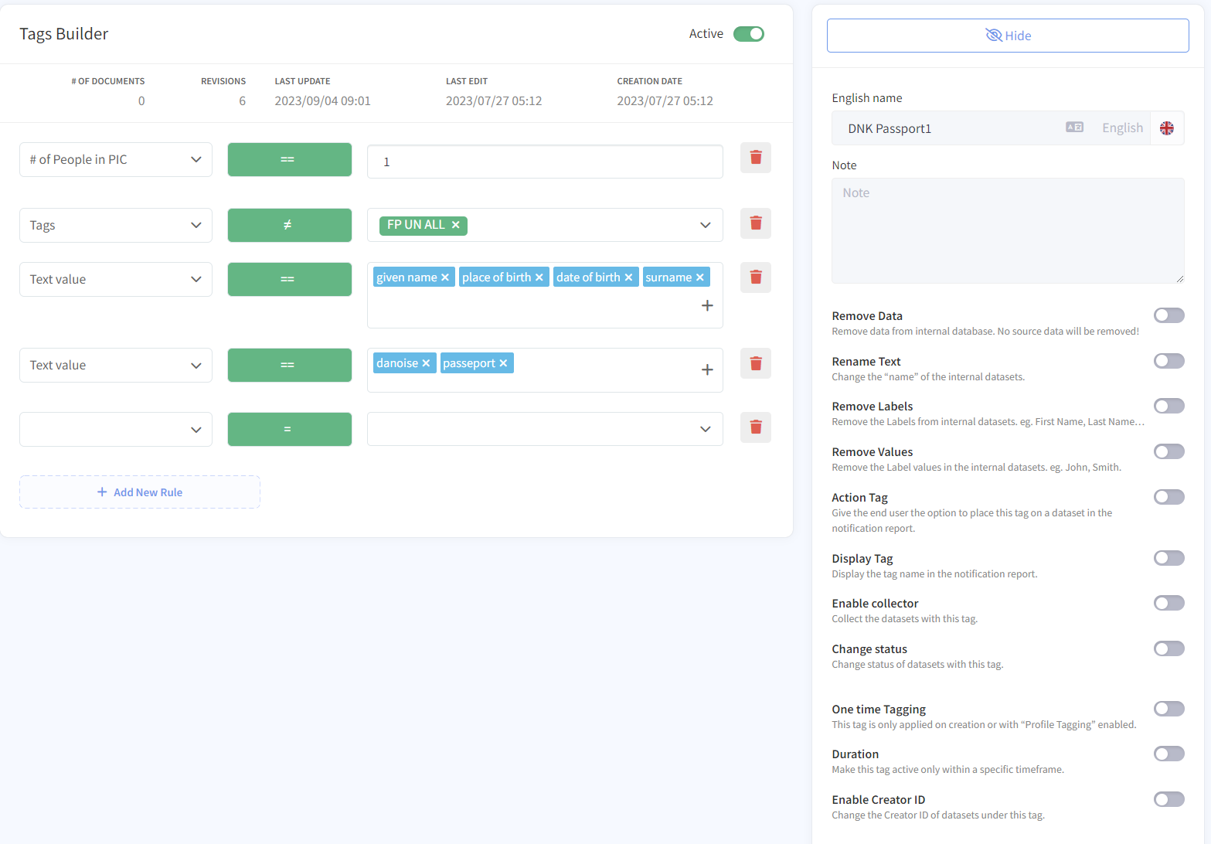
Data & More Compliance Solution – Classification principles
Example: Passport
DNK Passport1
(counter rule)
Tags

Slide 9
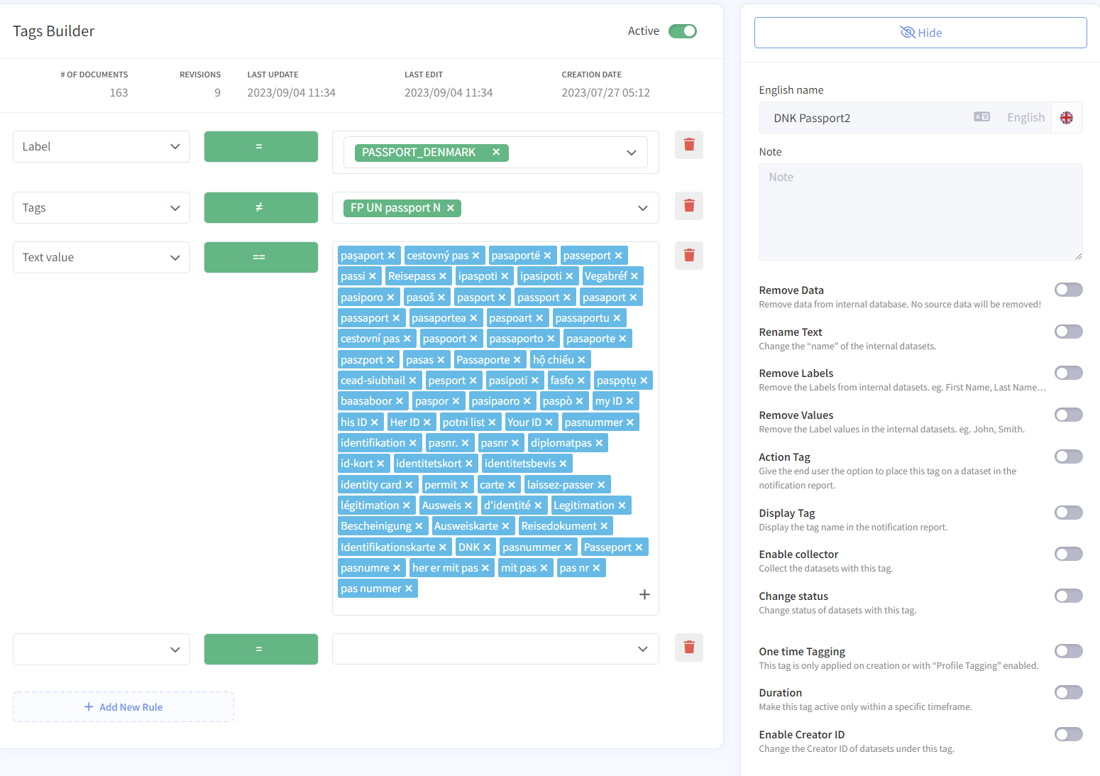
Data & More Compliance Solution – Classification principles
Example: Passport
DNK Passport2
(counter rule)
Tags

Slide 10

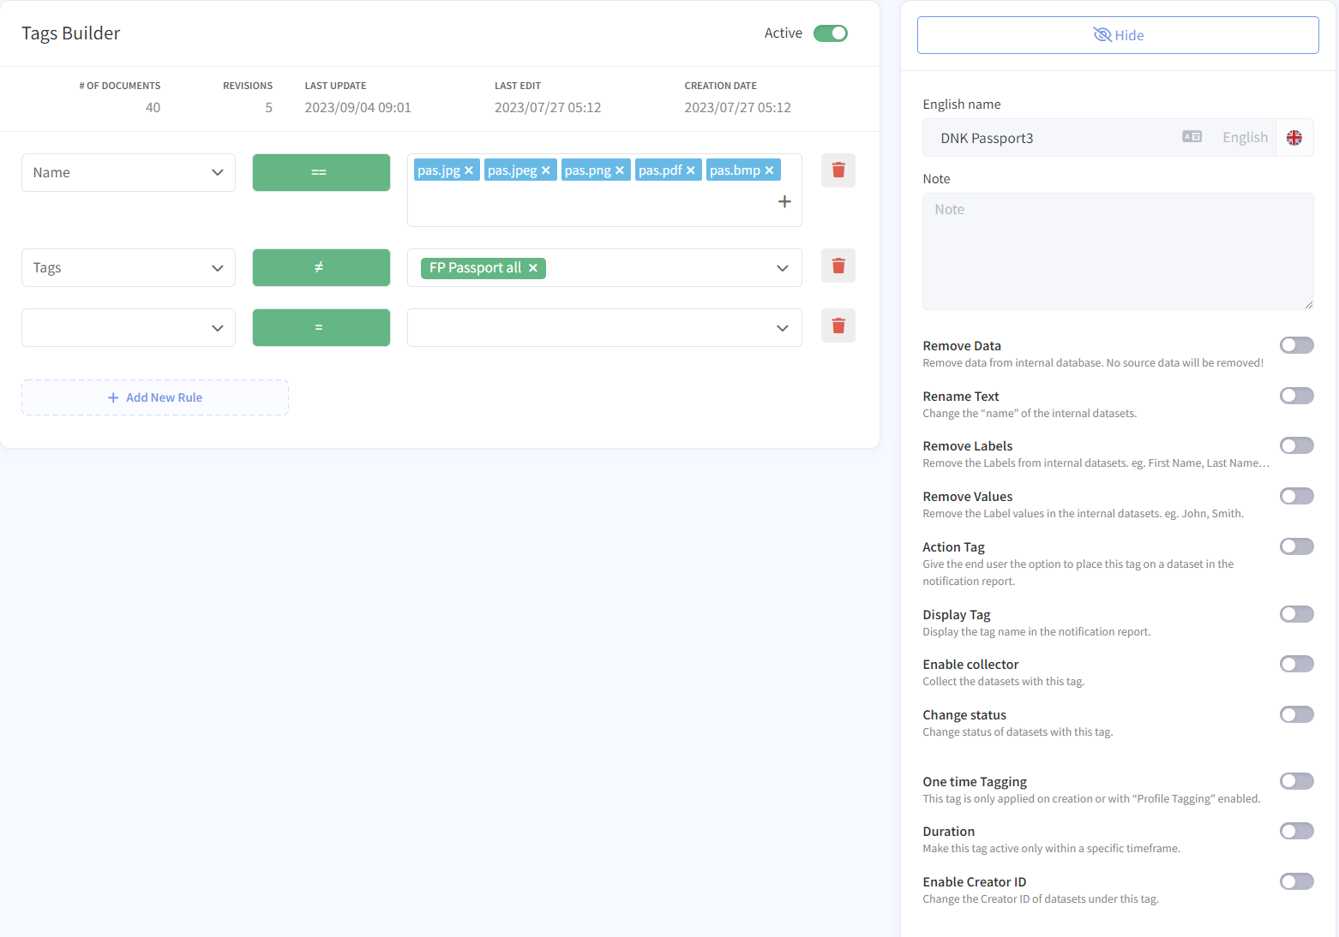
Data & More Compliance Solution – Classification principles
Example: Passport
DNK Passport3
(counter rule)
Tags

Slide 11
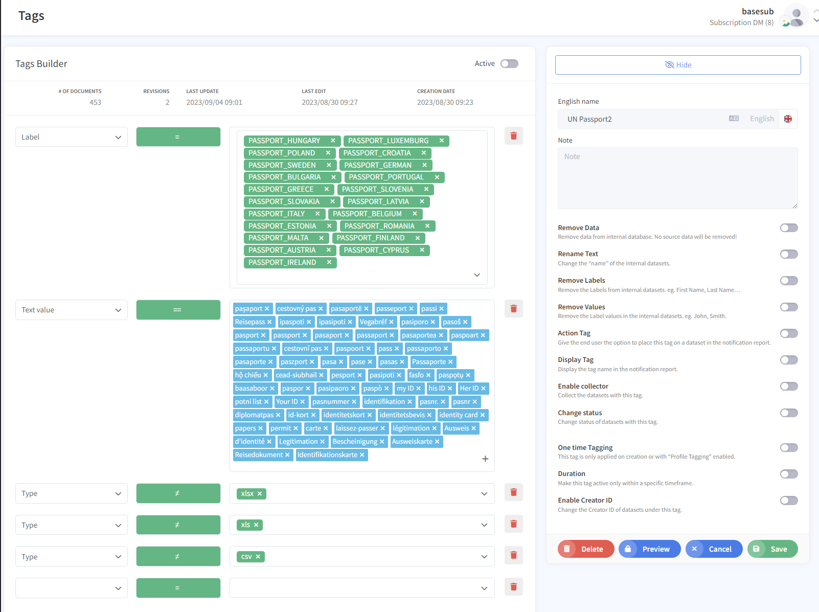
Data & More Compliance Solution – Classification principles
Example: Passport
UN Passport2
(counter rule)
Tags

Slide 12
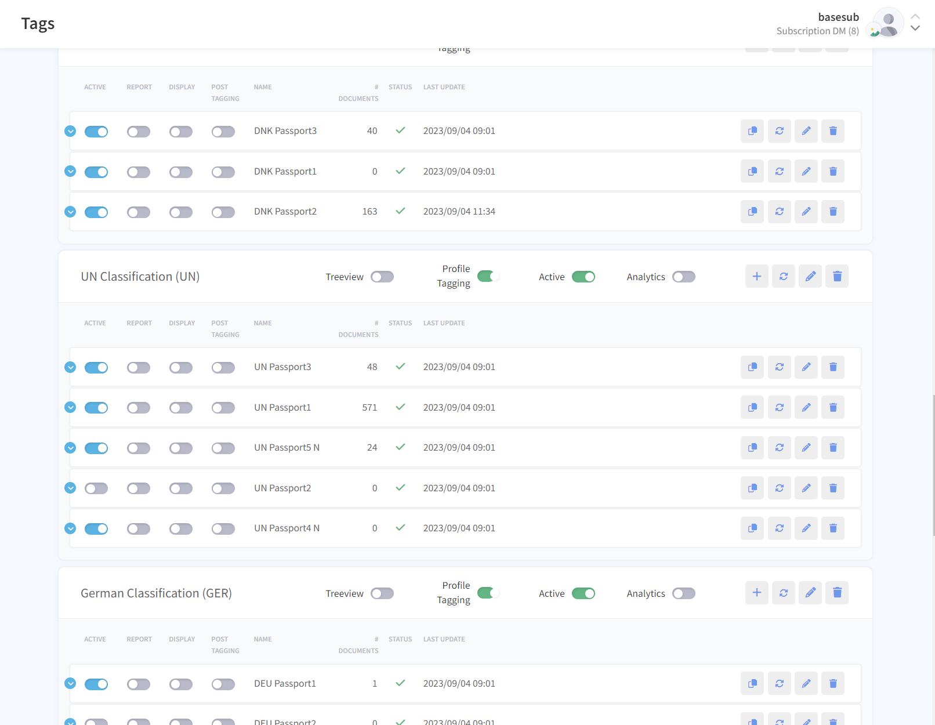
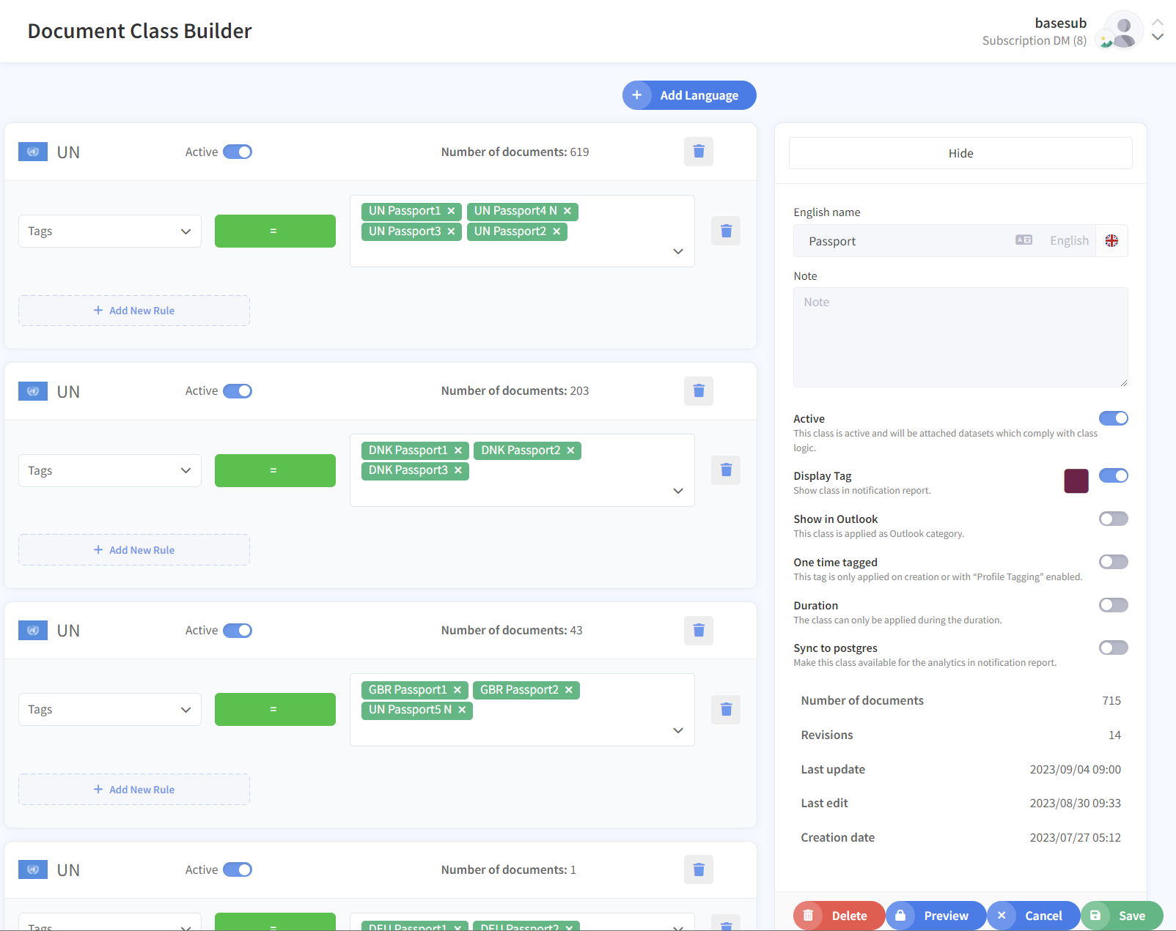
Data & More Compliance Solution – Classification principles
Example: Passport
There are many different types of tags in different languages
A Document class is a collection of tags
Tags
Doc Class

Slide 13
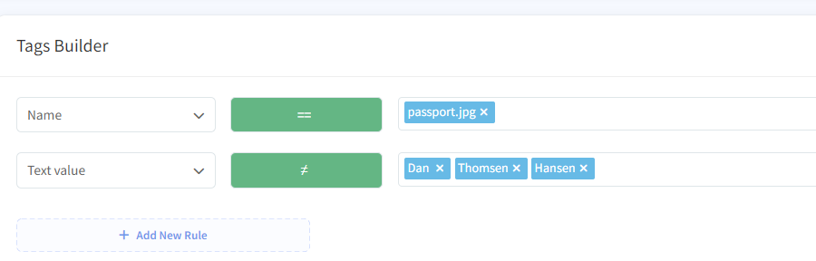
Data & More Compliance Solution – Classification principles
Do it logically
Test it
Did you find to much
Did you find all
Try again ☺
There is one no go:
Do not use multiple negations. Only one. If more a needed, create a FP tag with all in, and negate that single tag instead

Slide 14
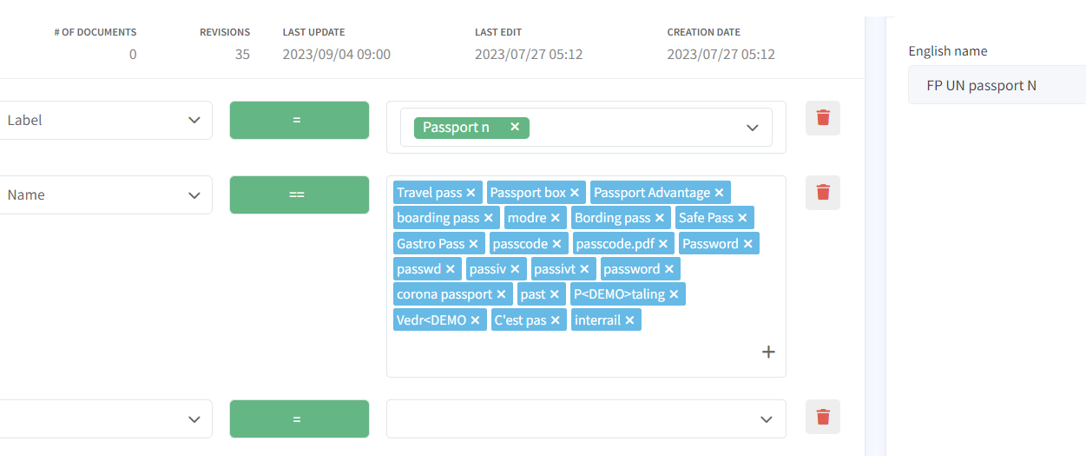
Data & More Compliance Solution – Classification principles
Example: Passport
False Positives Passport tag
(counter rule)
Tags

Slide 15
Data & More’s unique document classes identification
Confidential personal data document classes
European & international ID
  ID card, number or information
European & international Social security info
  Social security card, number or information
European & international health cards
  Health card, number or information
European & international drivers' licenses
  The card, number or information
European & international passports
  The passport, number or information
Credit cards
  The credit card, number or information
Tax information
  Tax returns etc.
Residence permit
  Permits and or information in them
Salary information
  Pay slips etc.
Employment documents
  Contracts etc.
Recruitment (Application/job offer/CV)
  Contains a wide range of information in connection with the recruitment process, job applications, CV, job interviews, etc.
Bonus agreements
  Bonus agreements
Dismissal or resignation
  Terminations or resignations
Written warnings
  Written warnings and expulsions
Criminal offences document classes
Criminal record
  Criminal records and information about them
Offences, fines and convictions
  Convictions, fines etc.
Sensitive personal data document classes
Health info
  Diagnoses, illnesses, medication and sick leave
Trade union membership
  Membership of a trade union
Ethnic origin
  Which country you come from or ethnic origin
Political orientation
  Political orientation, membership of a political party
Religious belief
  Religious orientation or member of a religion/church/congregation
Sexual orientation
  Information about sexual orientation
Non-sensitive personal data document classes
Pictures with a face
  Used for classification in different document classes
Travel information
  Information about bookings, reservations, flights in check-in, etc. showing where you have been at any given time
Developed and maintained by Data & More based on an analysis of over 2 billion documents. It is continuously optimized and improved
All rights reserved // Data & More @ 2021

Slide 16
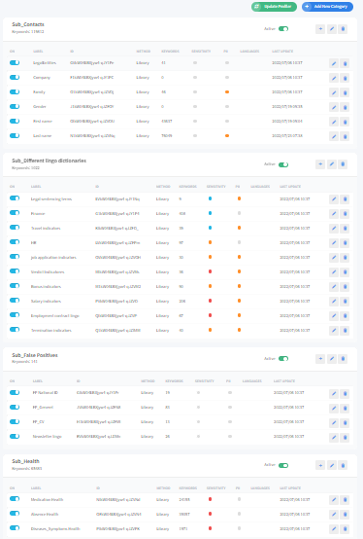
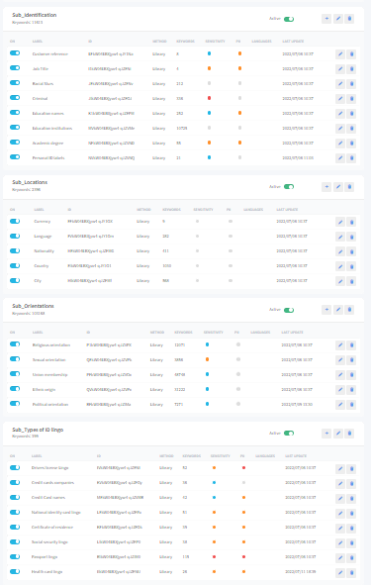
Data & More’s International dictionaries and phrases libraries
Data & More has a dedicated international team that maintain and updates language and country specific dictionaries and phrase libraries
All rights reserved // Data & More @ 2021

Slide 17
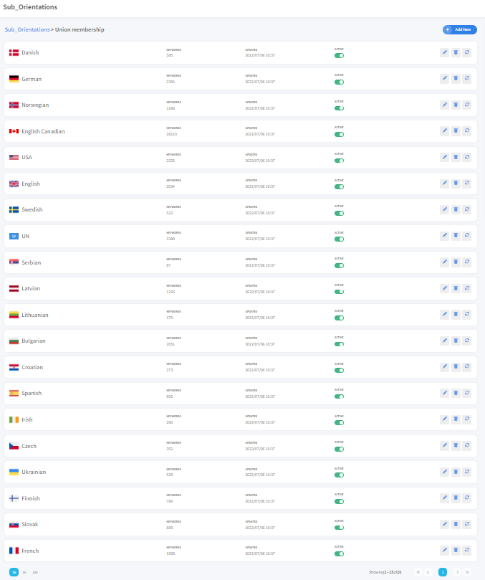
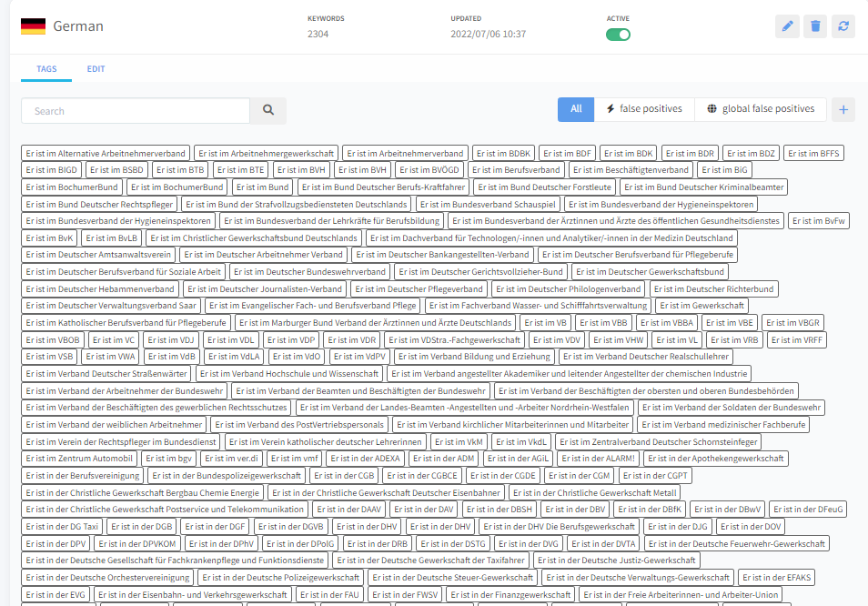
Example: Union phrase library:
List of all know unions in a country and their abbreviations & relevant phrases
Data & More has a dedicated international team that maintain and updates language and country specific dictionaries and phrase libraries
All rights reserved // Data & More @ 2021

Slide 18








Data & More the market best & unique data classification process and method
Data & More classification model is updated daily from the feedback from 100 000+ users, and all customer installations are on a daily basis updated, and data reclassified. Thereby always ensuring the most precise classification to minimize the effort users have to validate data.
Indexing more than 2 billion data objects
Continuous classification of customer data to identify non-compliant personal identify able data
Individual clean-up reports to 100000+ users
Validation from 100000+ users
Deletion of millions of non-compliant files
Each customers classification model is updated daily and data reclassified daily to have the most precise classification
Validated false positives and false negatives
Data & More central and custom develop multilingual data classification model, with:
500k + terms and entities
Language & country specific document classifications
Custom developed AI
200+ Custom developed regular expression
Data & More multilingual classification team evaluates and update and refined terms & entities, AI models, document classifications and regex on a daily basis to have the most precise possible classification
All rights reserved // Data & More @ 2023

Slide 19
Thank you

